Slide 1
Eclipse AH – Ditto Integration
Eclipse Arrowhead Bi-weekly Meeting
January 18, 2022
SRT, EISLab @ LTU
Presented by Abdullah Aziz Olov Schelén

Slide 2
Industrial device virtualization by digital twin (DT) as a proxy (DTaaP)
Energy efficiency
Devices can sleep (duty cycle) while DT services are available
Availability & persistence
DT provides storage, physical device can seamlessly be replaced
Contention control
Actuation of device may be offered to many, under strict control
Security
Devices not capable of strong security talks only to their DT, while the DT registers services and provides strong security

Slide 3
Status & coming steps
Status at LTU
A proof of concept (PoC) based on Eclipse Ditto has been developed
Paper to be published at International Conference on Industrial Technology and Management (ICITM), Oxford, UK, Feb 2022.
Challenges
The PoC is not yet integrated in Eclipse Arrowhead
The PoC delivers just partly on objectives (prev page)
Proposal
Integrate Ditto in Arrowhead (two options to be presented)
Evolve the DT concept towards the objectives

Slide 4
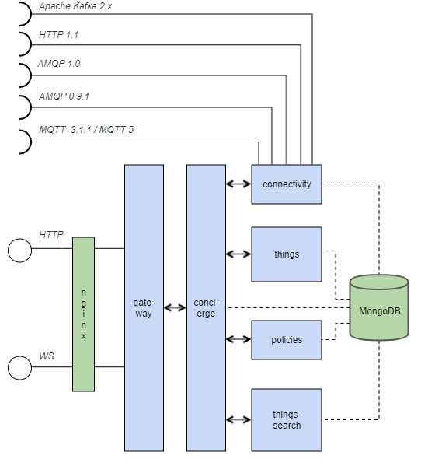
Eclipse Ditto Architecture
Ditto consists of multiple “microservices” as shown in the component view.
A “microservice” in Ditto :
has its own data store
has an API
can be accessed by other services only via the defined API

Slide 5
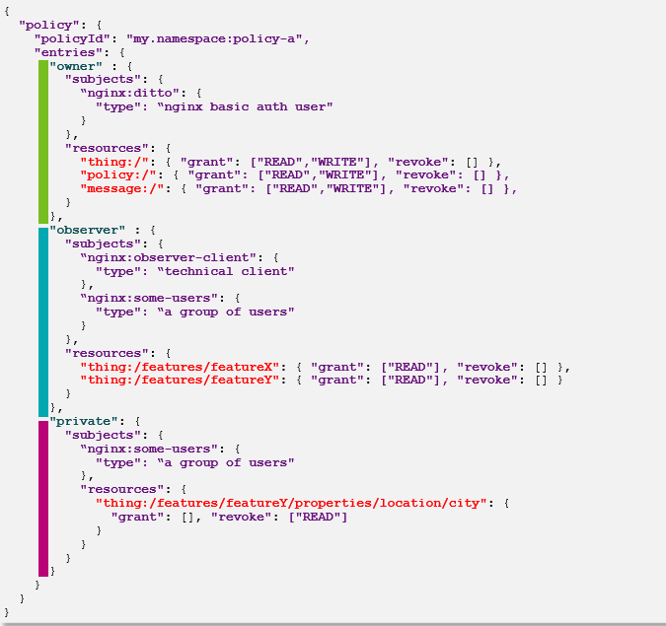
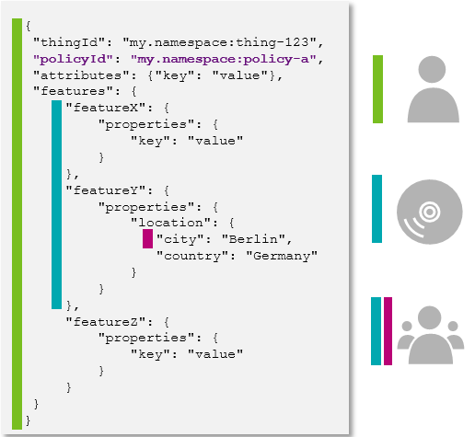
Eclipse Ditto Architecture
Policy
Thing

Slide 6
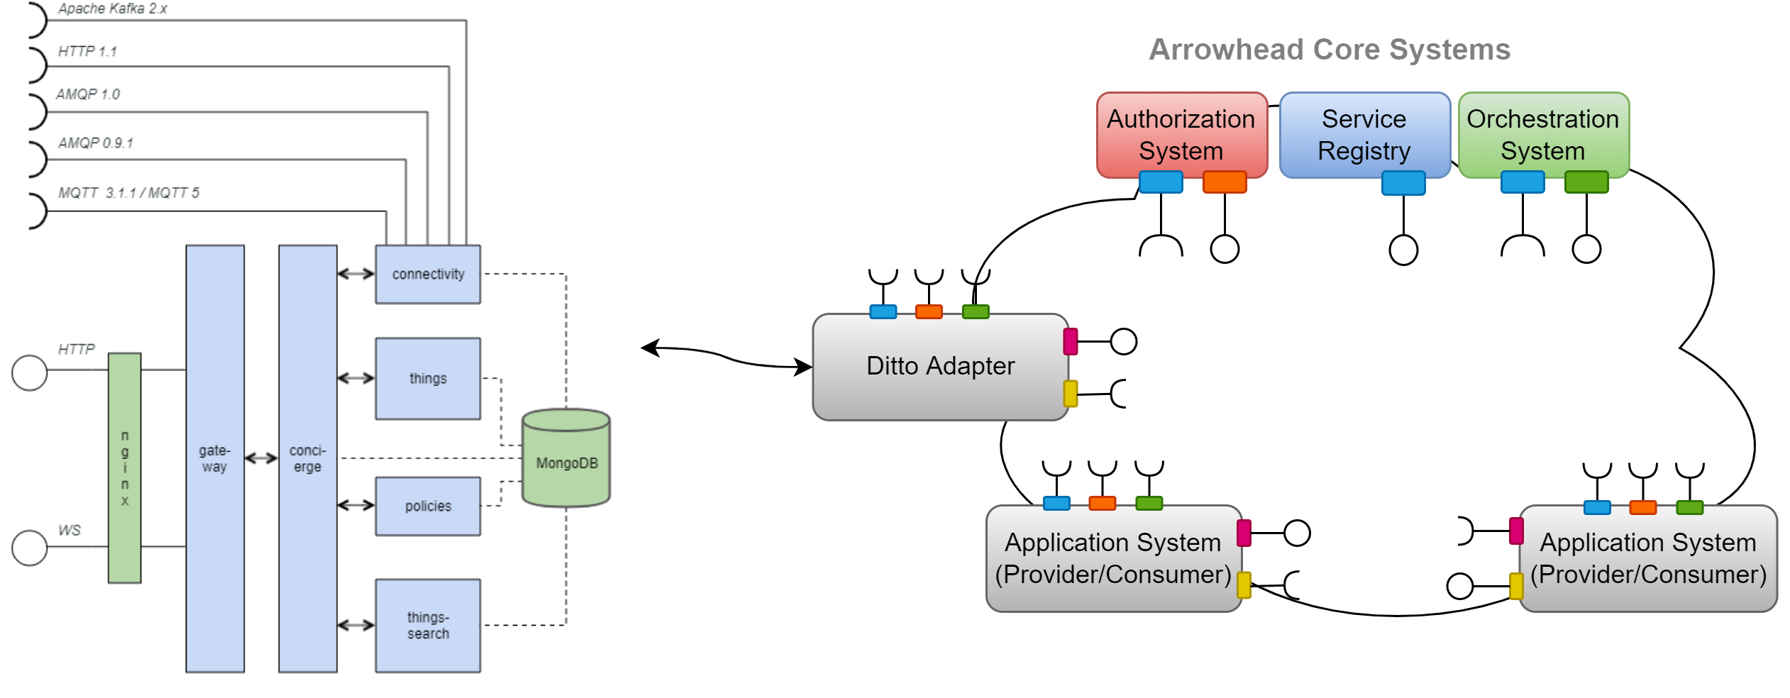
Option # 1
Pros
Seems easy and quick integration.
Good for prototype
Cons
Adapter need to expose all the services within Arrowhead against the Thing and Policies model.
Policies can be tricky, because of access rights based on users.
Seems to get more complex as DTs increase.

Slide 7
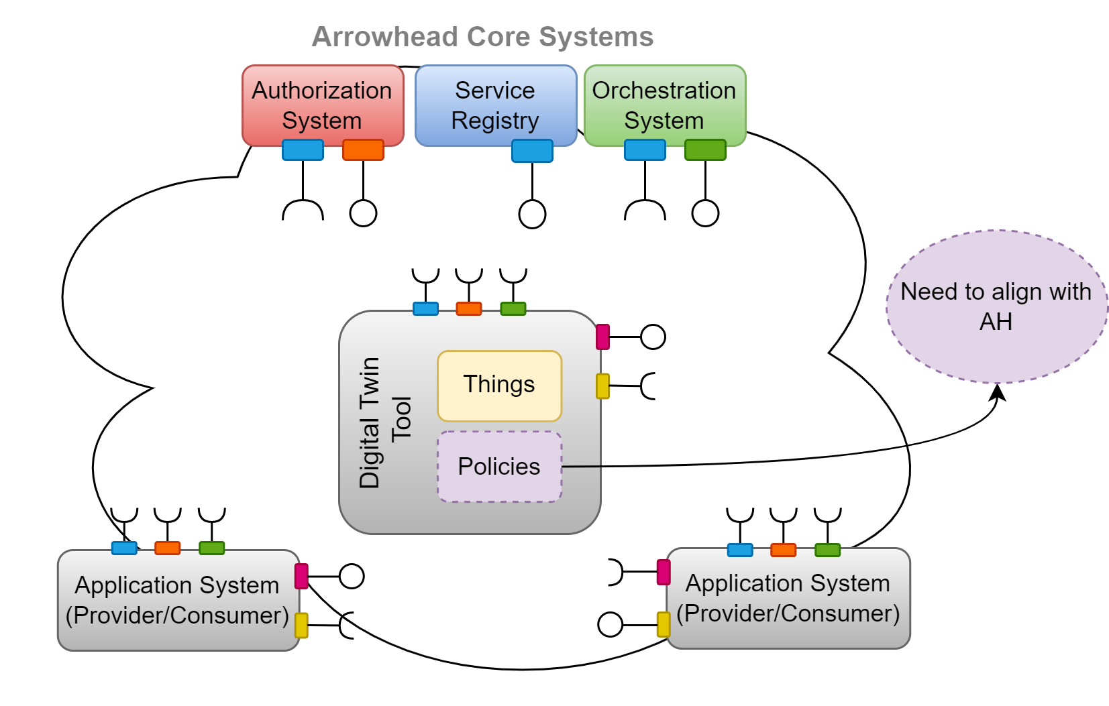
Option # 2
Pros
AH compliant digital twin tool with
AH security features
AH connectivity mechanism
AH interoperability
All AH supporting tools can be integrated
Seems more stable and scalable.
Cons
Needs to introduce and develop Ditto like Things components & align the Policies with AH.
Seems lengthy work.
Notes:
For future work,
The primary area of focus is to address the current limitations of DTaaP model, which are high availability and contention control.
We will upgrade DTaaP with respect to properties and implementations.
Also, we will introduce digital twin as a tool in Eclipse arrowhead framework.

Slide 8
Resources from LTU
Abdullah Aziz (PhD student)
Nicklas Nyström (software developer)
Ulf Bodin and Olov Schelén (supervisors)

